Slide 1
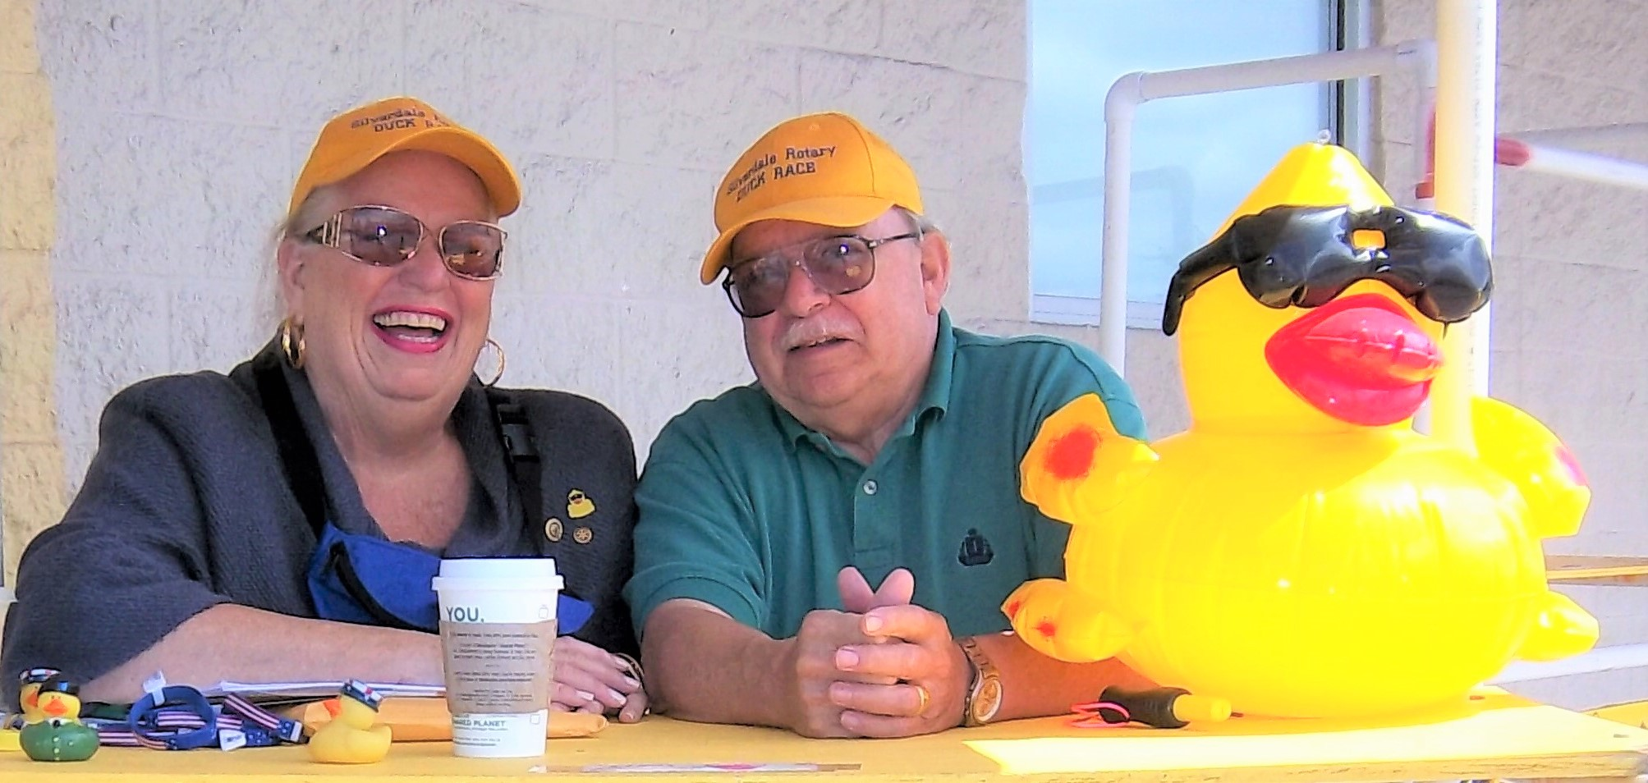
Don & Mary Gerry Taylor Rotary Memories
Married over 40 years

Slide 2
Don Taylor - Silverdale Rotary Club 1981-2021
Secretary twice, Club President in 1986-87
Multiple Paul Harris Fellow, Every Rotarian Every Year
Silverdale Rotary Foundation Chair, Membership chair several years
District 5020 Secretary several years
In January 2018 - awarded an Honorary membership in our Rotary Club

Slide 3
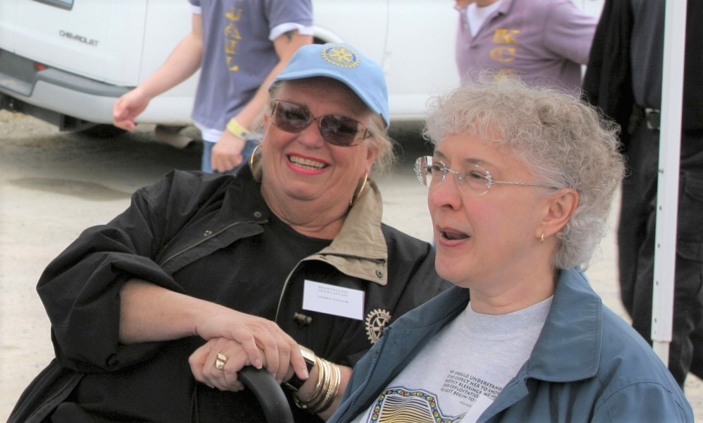
Mary Gerry Taylor - Silverdale Rotary Club 2004-2014
Multiple Paul Harris Fellow
Huge Rotary supporter even before joining Rotary
Kitsap Kids Renovation 2006 (with Ellen Newberg)

Slide 4
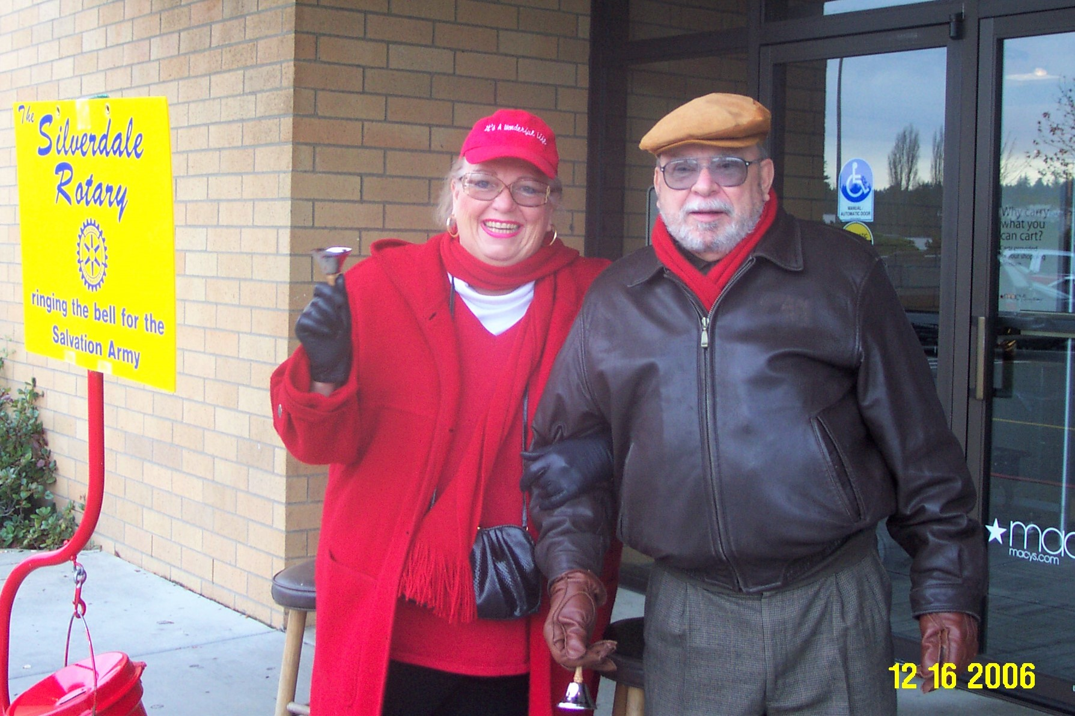
Bell Ringing at Macy’s - 2006

Slide 5
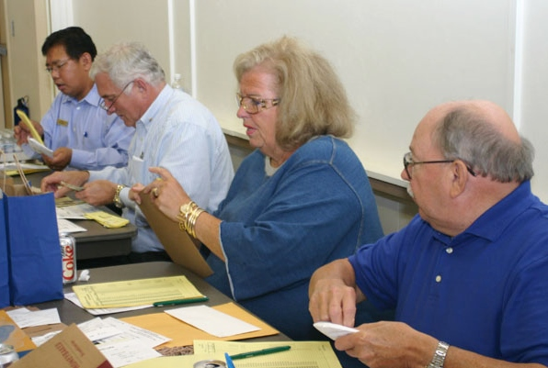
Duck Central – Mary Gerry and Don - 2006
With Virgil Valdez and Scott Slocum

Slide 6
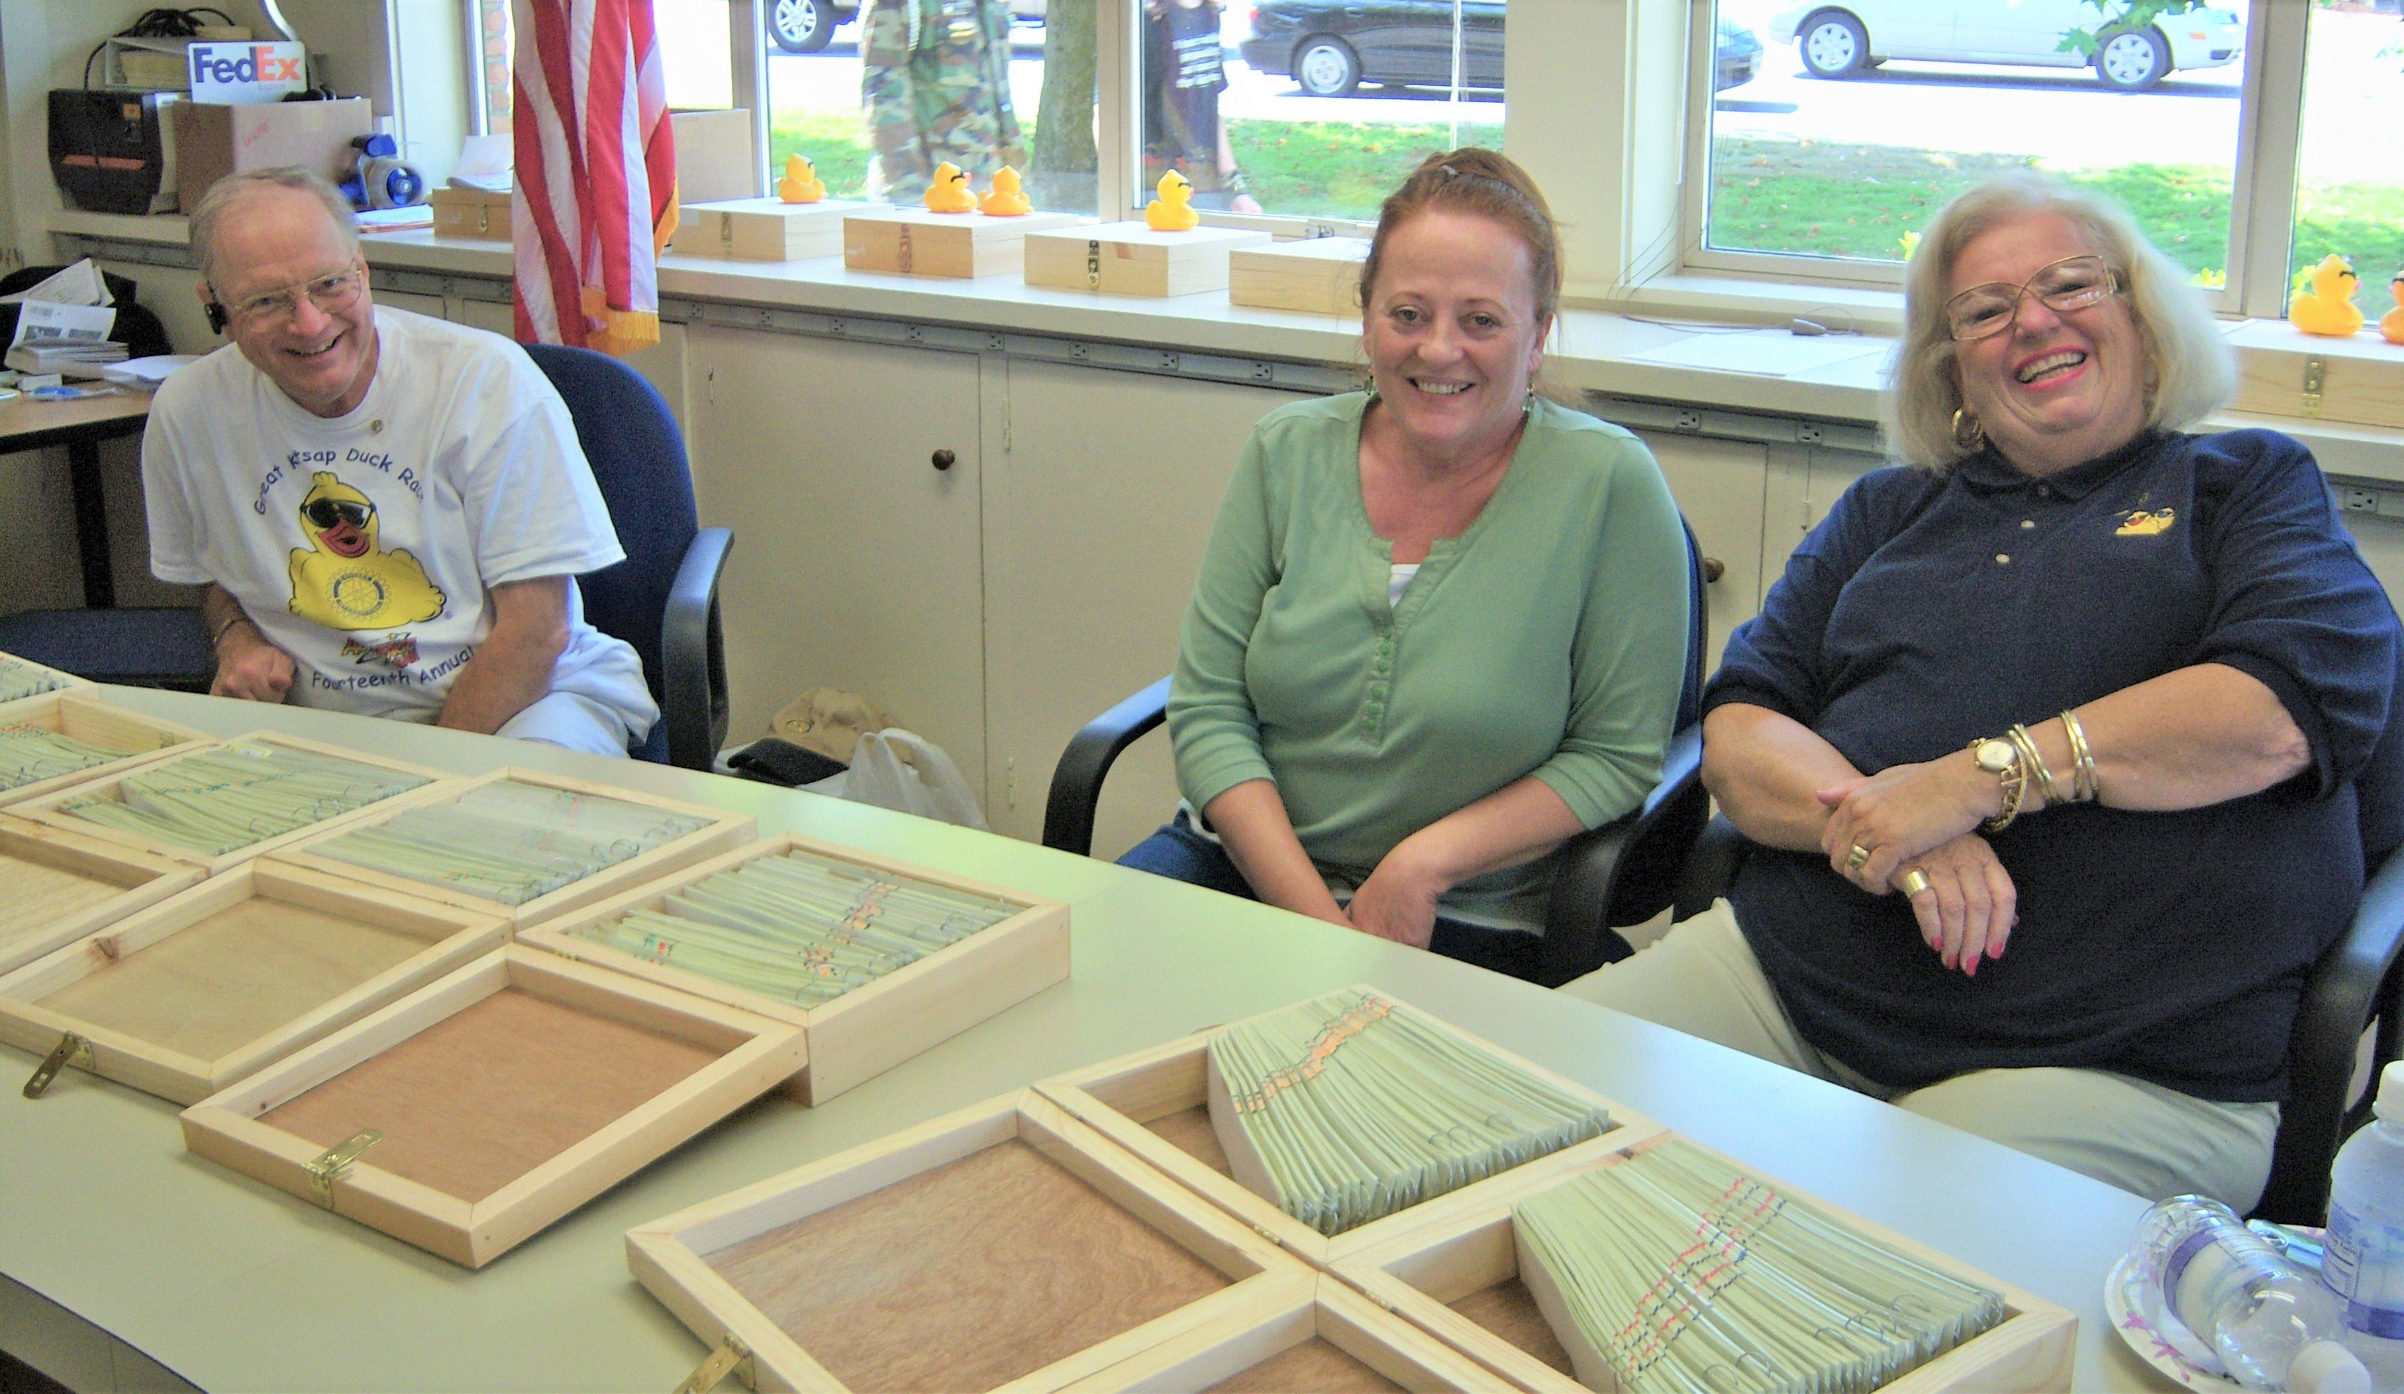
Duck Central – Mary Gerry - 2009
With Brian Beagle and Jill Slocum

Slide 7
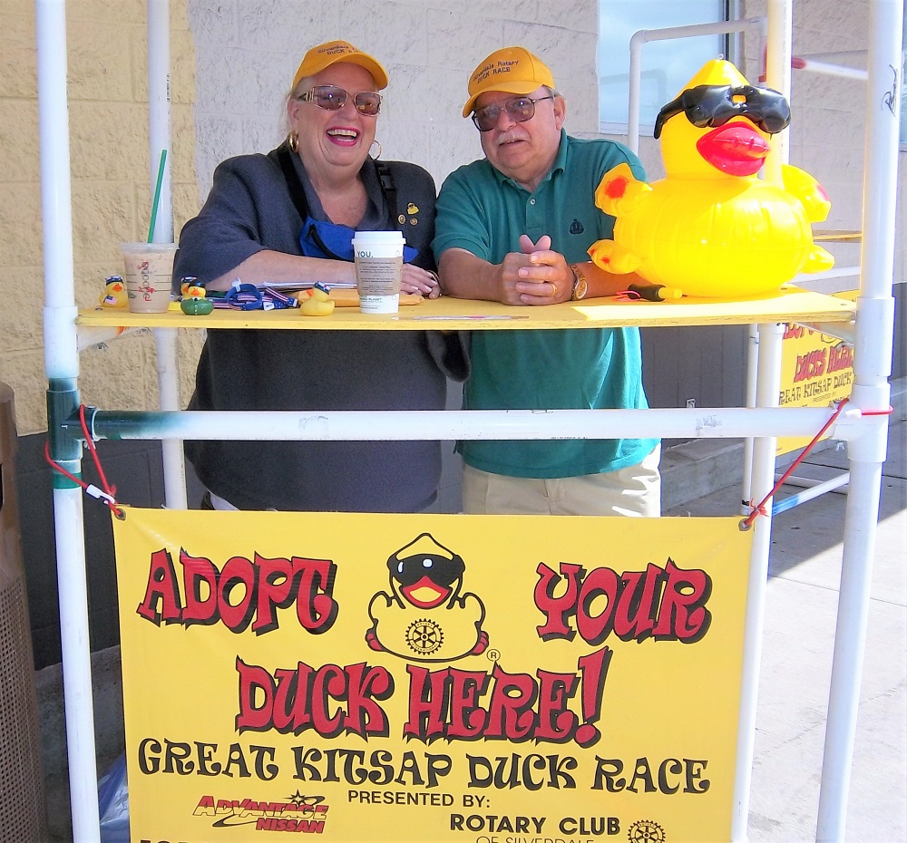
Selling Ducks – Mary Gerry and Don - 2010

Slide 8
Past Presidents at 2014 Installation Dinner
Left to right: Elayne Burton, Mary Hoover, Scott Slocum, Roger Aydt, Peter Matty, Ron Templeton, Larry Rodgers, Don Taylor, Brian Beagle, Jack Jensen

Slide 9
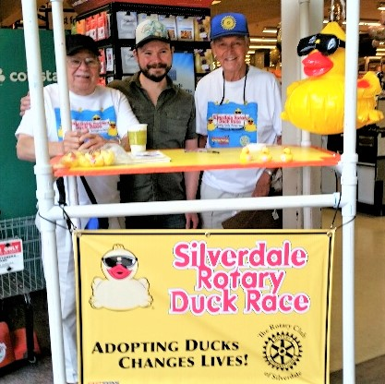
Selling Ducks – Don and son Tim, and Jack Jensen - 2017

Slide 10
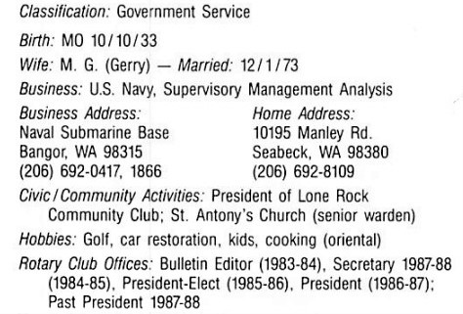
Don Taylor – 1988-89 Directory

